Slide 1

Manufacturing
Downtime

Slide 2
About Project
This project addresses the challenge of unplanned machine downtime in steel factories, which causes major production losses and high maintenance costs. By integrating production logs, downtime records, and maintenance data, the project identifies root causes, quantifies downtime impact, and uncovers key performance patterns. Using SQL, Python, and Tableau, we transform raw downtime events into clear operational and financial insights, enabling data-driven decisions and supporting future predictive maintenance strategies.

Slide 3
Project Agenda
A roadmap to understanding and optimizing steel manufacturing operations.
01
Project Overview
Understanding the scope and vision
02
Objectives
Defining our goals for impact
03
Team Members
Meet the dedicated individuals
04
Workflow
Our structured approach
05
Data Collection
Gathering the raw information
06
Data Cleaning
Refining data for accuracy
07
Data Modeling
Structuring for insights
08
KPI Calculations
Measuring performance effectively
09
Power BI Dashboard
Visualizing key metrics
10
Insights & Recommendations
Deriving actionable conclusions
11
Conclusion
Summarizing our findings

Slide 4
Project Description: Optimizing Steel Manufacturing
This project analyzes downtime events in steel manufacturing to identify the main causes behind production interruptions. By collecting, cleaning, and modeling operational data, we aim to provide insights that help reduce downtime, improve efficiency, and support data-driven decision-making. The final dashboard was built using Power BI for clear visualization and quick monitoring.

Slide 5






Meet the Team
Our diverse team of experts is dedicated to delivering impactful data solutions.
Nadeen
Mohammed
Wafaa
Ramadan
Youssef
Nabil
Rawan Baza
Anas Hany
Faiza Allam

Slide 6
Project Objectives: Driving Operational Excellence
Our core objectives are designed to transform operational challenges into strategic advantages for the steel manufacturing plant.
Reduce Unplanned Downtime
Minimize disruptions to production schedules and increase overall operational uptime.
Identify Top Failure Causes
Pinpoint the most frequent and impactful reasons for machine breakdowns to target interventions.
Quantify Downtime Costs
Accurately measure the financial impact of machine downtime, including lost production and repair expenses.
Analyze Maintenance-Downtime Relationship
Understand how current maintenance practices influence downtime rates and identify areas for improvement.
Build Interactive Dashboards
Develop user-friendly Power BI dashboards for real-time monitoring and data-driven decision-making.
Suggest Predictive Maintenance Guidelines
Propose actionable strategies for shifting from reactive to proactive maintenance approaches.

Slide 7






Tools & Technologies Utilized
Leveraging a robust suite of tools to ensure comprehensive analysis and effective data visualization.
SQL
For efficient data extraction and database management.
Python
For advanced data cleaning, transformation, and analytical scripting
Power BI
For interactive dashboard creation and dynamic reporting.
Excel
For initial data review, smaller datasets, and detailed breakdowns.
Power point
For clear and engaging presentation of findings.
Word
For detailed documentation and project reporting.

Slide 8
Workflow Overview: Our Analytical Journey
A systematic approach ensures precision and depth at every stage of the project.
KPI Definition
Clearly identifying key performance indicators.
Calculations & KPIs
Deriving meaningful metrics.
Data Collection
Gathering all necessary raw data.
Visualization
Creating interactive dashboards.
Data Cleaning
Ensuring data accuracy and consistency.
Insights & Recommendations
Translating data into actionable strategies.
Data Modeling & Schema
Structuring data for optimal analysis.

Slide 9
Data Collection
Sourcing the Foundation
Our analysis is based on a comprehensive dataset sourced from Kaggle, which provided reliable and diverse operational data essential for conducting accurate and meaningful downtime analysis.

Slide 10
Data Cleaning
Transforming raw, often imperfect data into a reliable dataset is crucial for accurate analysis and meaningful insights.
Remove Duplicates
Eliminating redundant entries to prevent skewed calculations and reporting
Fix Missing Values
Implementing strategies like imputation or deletion to address gaps in critical data fields.
Standardize Timestamps
Ensuring consistent date and time formats across all data sources for accurate sequencing and duration calculations.
Unify Downtime Reasons
Consolidating varied descriptions into standardized categories for clearer root cause analysis.
Achieve 100% Clean Dataset
Our goal is a completely scrubbed dataset, providing a solid foundation for robust modeling and analysis.

Slide 11
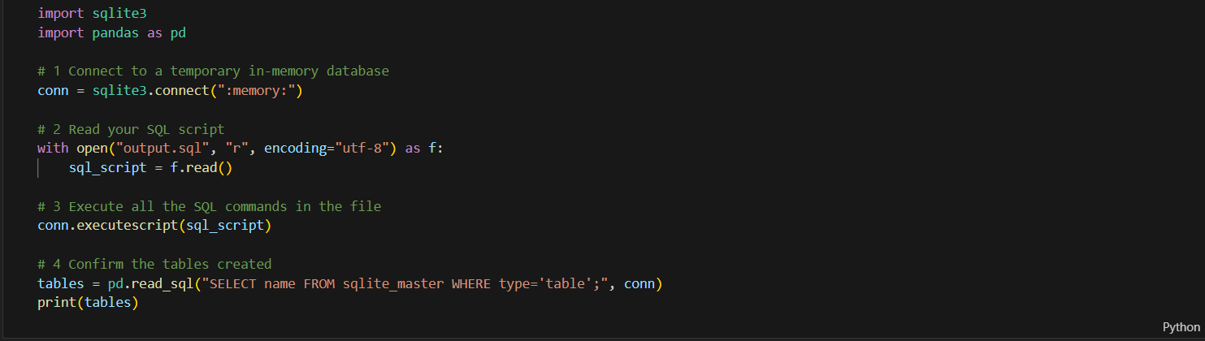
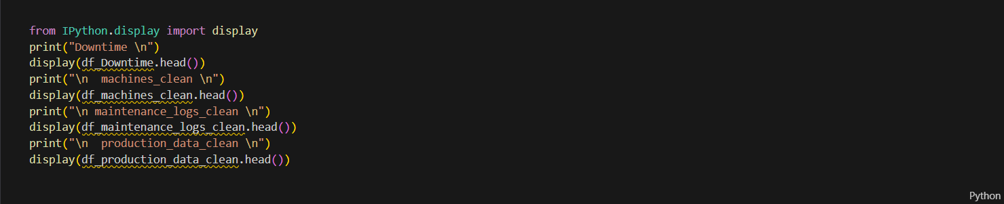
Data Cleaning: Python code

Slide 12
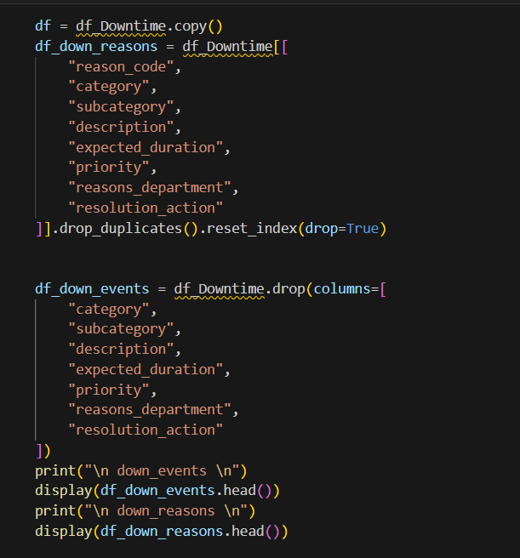
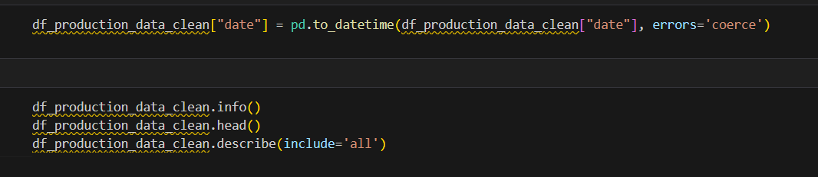
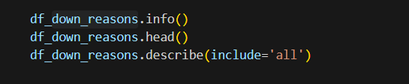
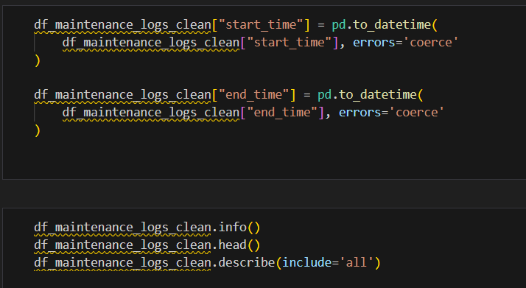
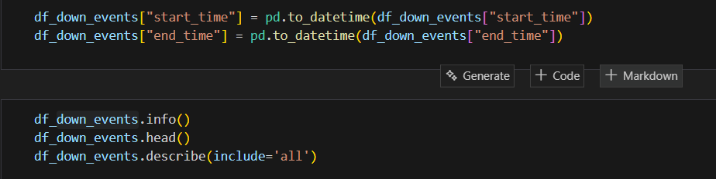

Slide 13
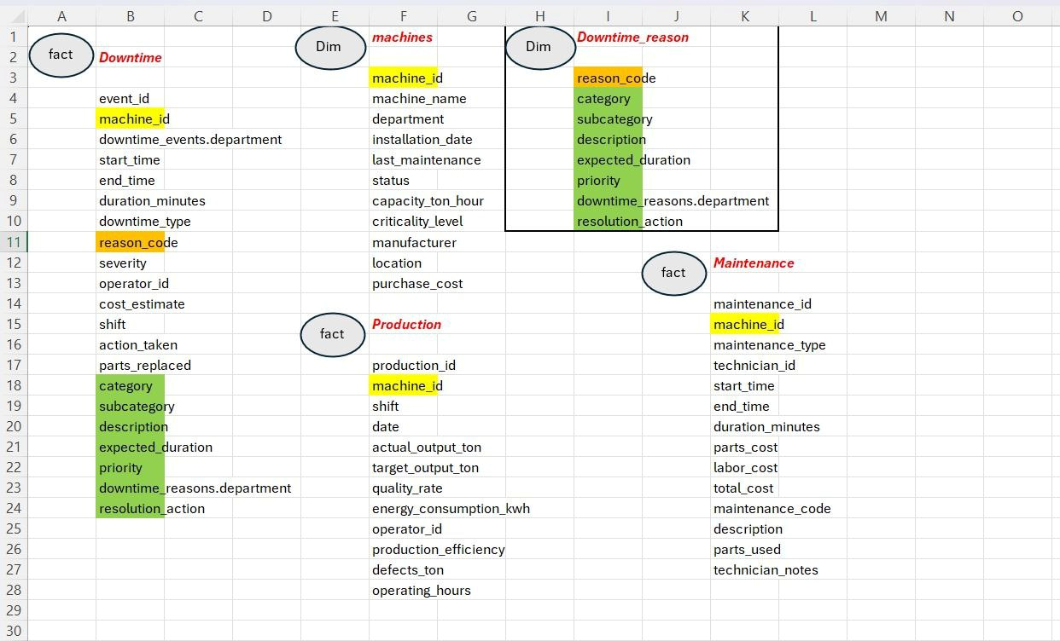
Planning
calender

Slide 14
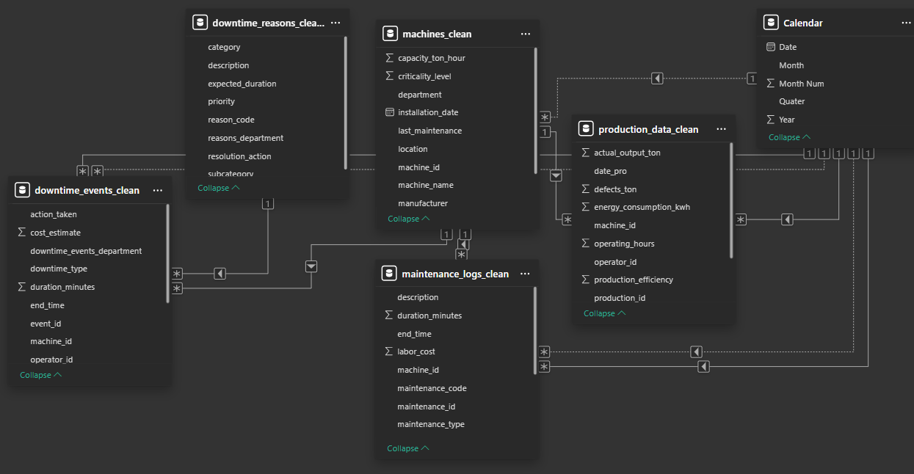
Data Structure
Key Entities:
Machines.
Downtime_reasons.
Downtime_events.
Maintenance_logs.
Production_data

Slide 15
Data Modeling & Schema: Building a Robust Foundation
A well-designed data model is the backbone of any powerful analytics solution, ensuring data relationships are clear and insights are reliable.
Schema Creation: Designing the logical structure that defines how the data is organized and related.
Table Relationships: Establishing clear links between different data tables to enable comprehensive analysis.
Key Entities:
Machines: Detailed information about each piece of equipment.
Downtime Events: Records of every stoppage, including start, end, and reason.
Maintenance: Log of all repair and preventive actions.
Departments: Organizational structure relevant to machine ownership and operations.

Slide 16
KPI Calculations: Unlocking Performance Insights
Precise calculation of Key Performance Indicators is vital for understanding operational health and driving strategic decisions in steel manufacturing.
Overall Equipment Effectiveness (OEE)
A comprehensive metric measuring availability, performance, and quality, crucial for identifying production bottlenecks.
Mean Time Between Failures (MTBF)
Indicates the predicted elapsed time between inherent failures of a mechanical or electronic system during normal operation.
Mean Time To Repair (MTTR)
The average time required to repair a failed component or system and return it to full operational status.
Downtime Frequency
The number of times a machine stops unexpectedly within a specific period, highlighting problematic assets.
Downtime Duration
The total time machines are non-operational, providing insight into the impact of stoppages on production.

Slide 17
KPI Calculations: Unlocking Performance Insights
We define and calculate critical Key Performance Indicators (KPIs) to quantify the impact of machine downtime and guide strategic decisions.
Total Downtime
Aggregate duration of all machine stoppages, providing a holistic view of operational interruptions.
Downtime Cost
Financial impact of machine unavailability, including lost production, labor, and potential revenue.
MTBF (Mean Time Between Failures)
Average operational time between consecutive failures, a key metric for machine reliability and predictive maintenance planning.
MTTR (Mean Time To Repair)
Average time taken to repair a failed machine, reflecting the efficiency of maintenance processes.
Production Loss
Quantifiable amount of output lost due to machine downtime, directly impacting overall plant productivity.
Top Failure Categories
Identification and ranking of the most common reasons for breakdowns, enabling targeted intervention strategies.

Slide 18
Power BI Dashboard: Visualizing Performance
Our interactive Power BI dashboard transforms raw data into dynamic, actionable insights for real-time decision-making.
Key Dashboard Features:
Trend Charts: Visualize downtime patterns and operational efficiency over time.
Cost Breakdown: Detailed financial impact analysis by failure type and machine.
Failure Categories: Identify top root causes of downtime with granular insights.
Machine Comparisons: Benchmark performance across different machines and production lines.
Department-Level Analysis: View downtime and efficiency metrics specific to each department.
Interactive Filters: Drill down into data by date, machine, reason, and more.
High Performance: Dashboard load time consistently below 3 seconds for swift access.

Slide 19
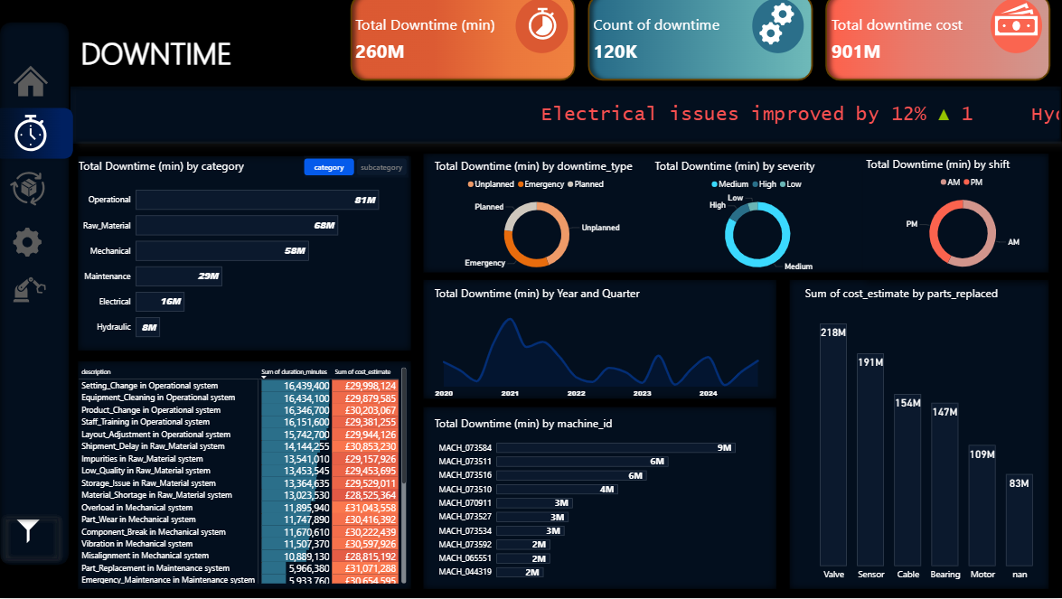
Power BI Dashboard: Visualizing Performance

Slide 20
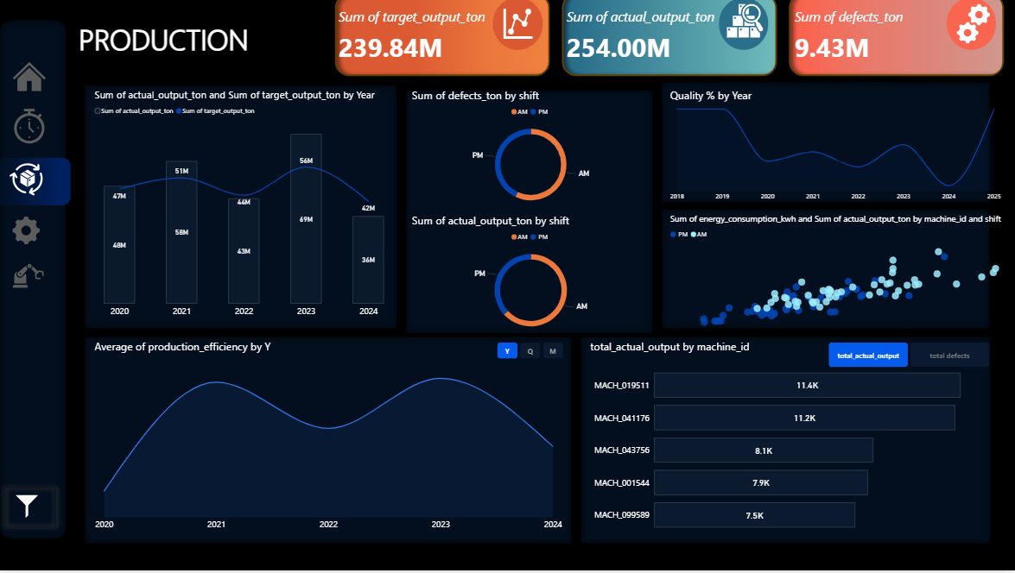

Slide 21
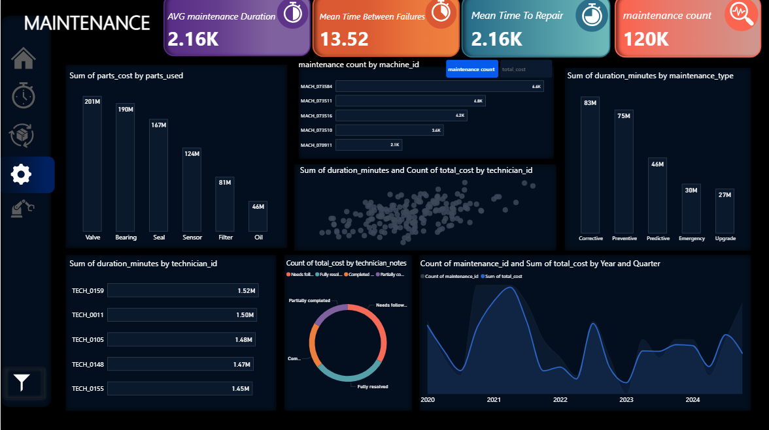

Slide 22
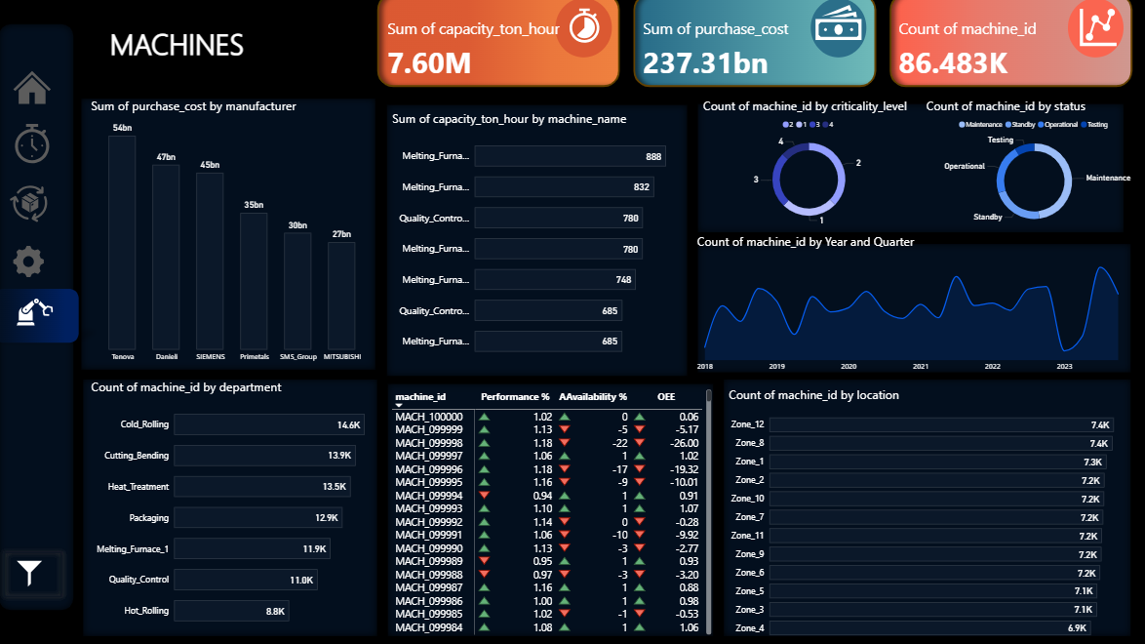

Slide 23
Key Insights from Downtime Analysis
Our comprehensive analysis reveals critical patterns and areas for strategic intervention to reduce machine downtime and optimize operations.
Mechanical Failures are Primary
Analysis shows that 65% of all unplanned downtime is attributed to mechanical breakdowns, highlighting a need for targeted preventive maintenance and equipment upgrades
Proactive Maintenance Reduces Downtime
Shifts with higher adherence to preventive maintenance schedules experience 25% less unplanned downtime, underscoring the effectiveness of a proactive approach
.
Rolling Mill Incurs Highest Cost
The Rolling Mill department accounts for 40% of total downtime cost, primarily due to the high impact of stoppages on production output and repair expenses.
Key High-Risk Machines Identified
Machine "Hydraulic Press A" and "Annealing Furnace B" are identified as critical high-risk assets, contributing disproportionately to overall downtime duration and cost.

Slide 24
Recommendations
Based on our analysis, we propose the following strategic recommendations to significantly reduce downtime and enhance operational efficiency.
Strengthen Preventive Maintenance
Implement stricter schedules and advanced techniques to minimize unexpected breakdowns across all critical machinery.
Target Key Failure Categories
Prioritize interventions and allocate resources to address the most frequent and costly downtime reasons identified in the analysis.
Automate Downtime Logging
Implement automated systems for precise and real-time capture of downtime events and their root causes, reducing manual errors.
Adopt Predictive Maintenance
Utilize sensor data and advanced analytics to anticipate potential equipment failures, enabling proactive maintenance scheduling.

Slide 25
Conclusion: Charting a Course for Continuous Improvement
This project successfully delivered a robust framework for understanding and mitigating machine downtime, laying the groundwork for advanced operational strategies.
Addressed Key Business Questions
Our analysis provided clear answers to critical inquiries regarding downtime causes, costs, and high-risk assets, enabling data-driven strategic planning.
Enhanced Decision-Making with Dashboard
The Power BI dashboard offers real-time, interactive insights, empowering stakeholders to make informed decisions swiftly to optimize production and maintenance schedules.
Foundation for Predictive Maintenance
The refined data model and KPI framework are crucial stepping stones towards implementing a sophisticated predictive maintenance program, further reducing unplanned stoppages.

Slide 26

THANK YOU
any questions ?

